Slide 1
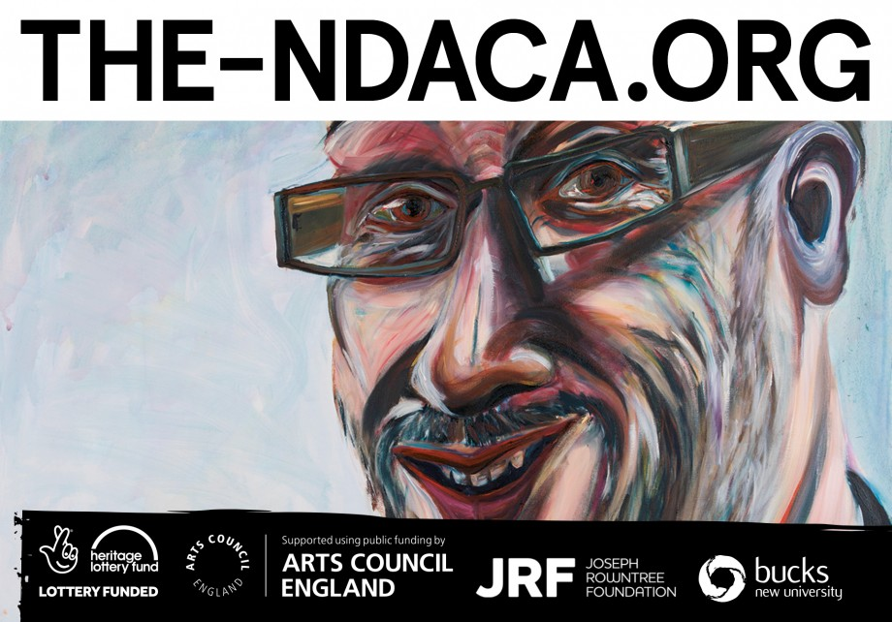
NDACA GOES LIVE IN APRIL 2018!
Notes:
Disability History Month gives us an opportunity to think about Disability currently - not just historically – though I think Disability History and Disability Arts are inextricably linked…
Disability Arts has been described as the last Avant-Garde with disabled artists as agents for change, calling out injustice, oppression, prejudice, and discrimination.
And many years ago, as an artist using disability as a source material for my own work, I met others making work that I thought was powerful and insightful…
But I never saw Disability Arts in public galleries, even though I thought it was everything that I wanted Art to be… so as Director of an organisation I began to collect it, disabled artists were dying, work lost, we needed to do something, that something became NDACA, the national disability arts collection and archive. Now being delivered by Shape Arts and with partners, including Bucks New University.
NDACA is a HLF project, with additional funding from ACE and the Joseph Rowntree Foundation, we go live in April 2018.
Next Slide….

Slide 2
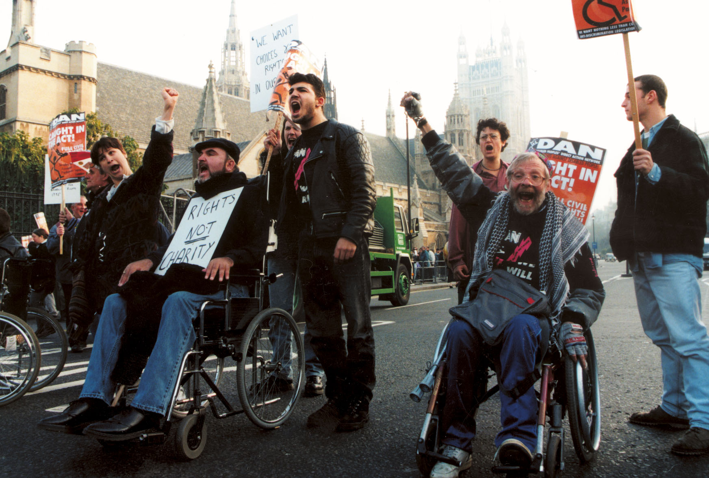
Notes:
We often refer to NDACA as demonstrating the Golden Age of disability arts and the politics of a time when disabled people broke barriers and forced through civil rights legislation, making it illegal to discriminate against us – that was over 21 years ago –
21 years later, do you think we are still facing Discrimination?
Well, Hate Crime against disabled people rose by 53% in 2016 – 53% - and often isn’t even recorded…
In 2010, the DDA, the disability discrimination act, became subsumed into the Equality Act – many say watered down - losing the ground we fought for, with disabled people being the hardest hit by the austerity of the last decade –
NEXT SLIDE..

Slide 3
To mark half a century of progress… Caroline Cardus The Way Ahead…
Notes:
Sometimes I think we see history as a way of demonstrating progress But to quote Hegel; we learn from history that we don’t learn from history…
This Installation by disabled artist Caroline Cardus always reminds me of our of history,
- humanity was able to send a man to the moon back in 1969, a small step for man - but not for disabled mankind, no, we would have to wait a further 50 years before legislators considered it necessary to make public transport accessible –
and as we lurch inexorably towards 2020 I’m certain that milestone will be missed…
It a good example of how art can have impact, just as we are programmed to obey road signs, we can see this as a signpost to the lack of progress to deliver our emancipation as disabled people….

Slide 4
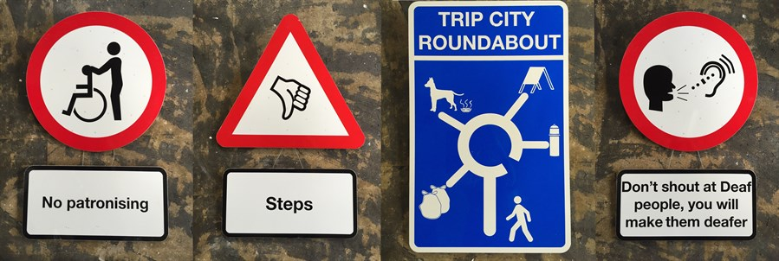
Notes:
The Social Model of Disability asserts that we are disabled by the barriers society constructs, be they physical, attitudinal or sociological barriers…
The Shape Arts website explains the Social Model of disability…check it out...
These works signpost some of the issues that disabled people raise as barriers to our inclusion… like not being able to use ‘so-called’ public transport, not being patronised … discovering the restaurant, theatre, or gallery is not accessible…
As disabled people, we are an oppressed minority, a large minority though - around 13 million, almost one in five of the UK population, an open and welcoming group – because of course the longer you lot live, the more likely you are to come and join us…!
Next Slide

Slide 5
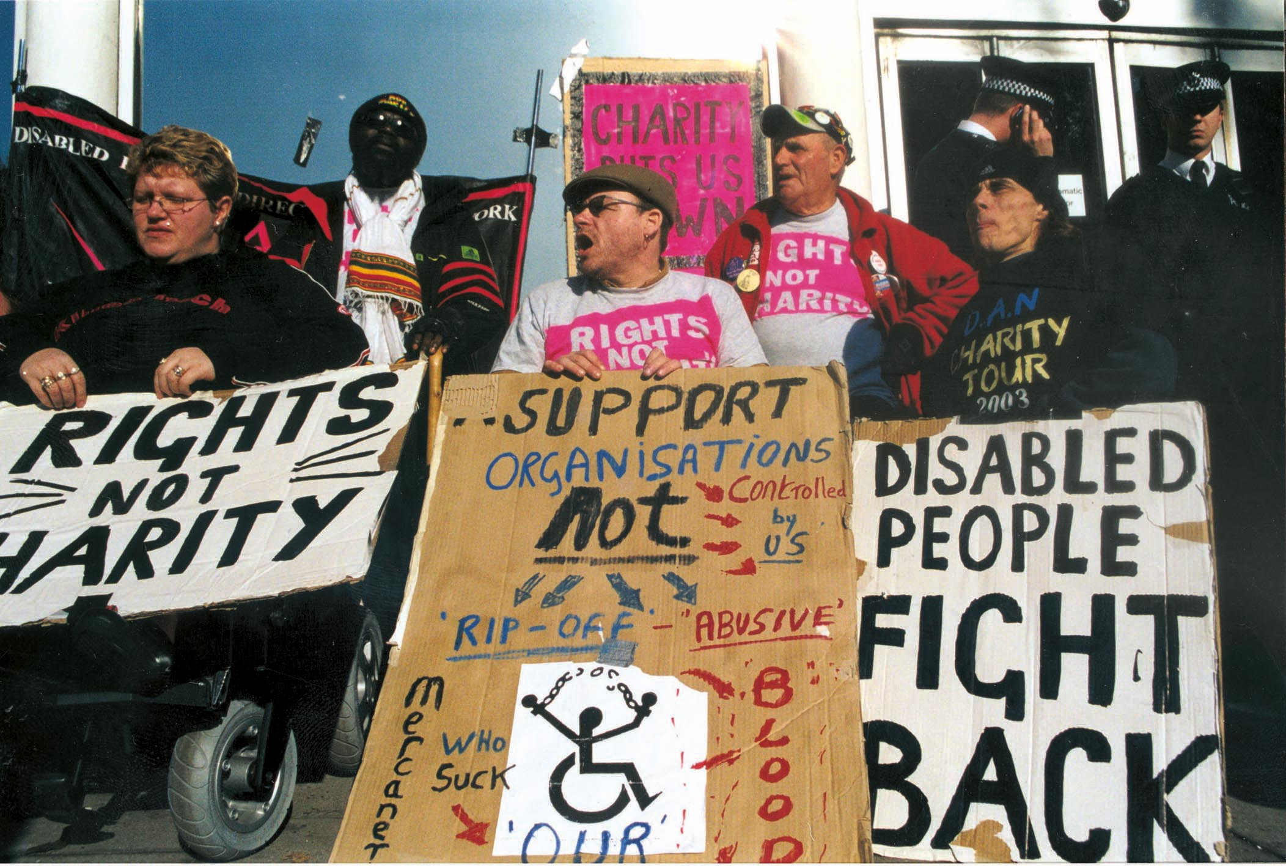
Notes:
These photographs from the NDACA collection are from 25 years ago but they could be from right now as disabled people are once again the hardest hit by the cuts that are having such a swingeing effect on us…

Slide 6
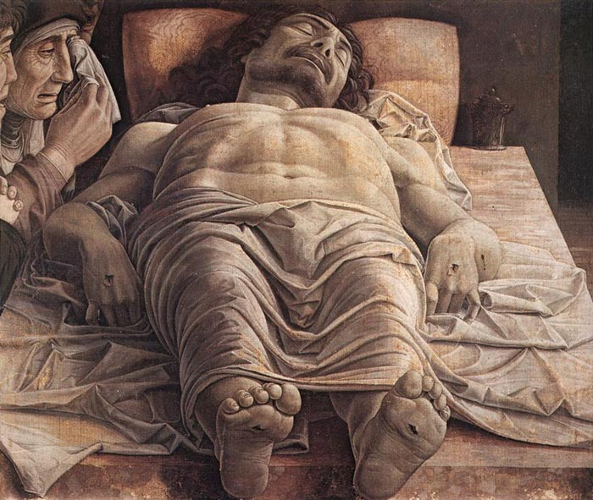
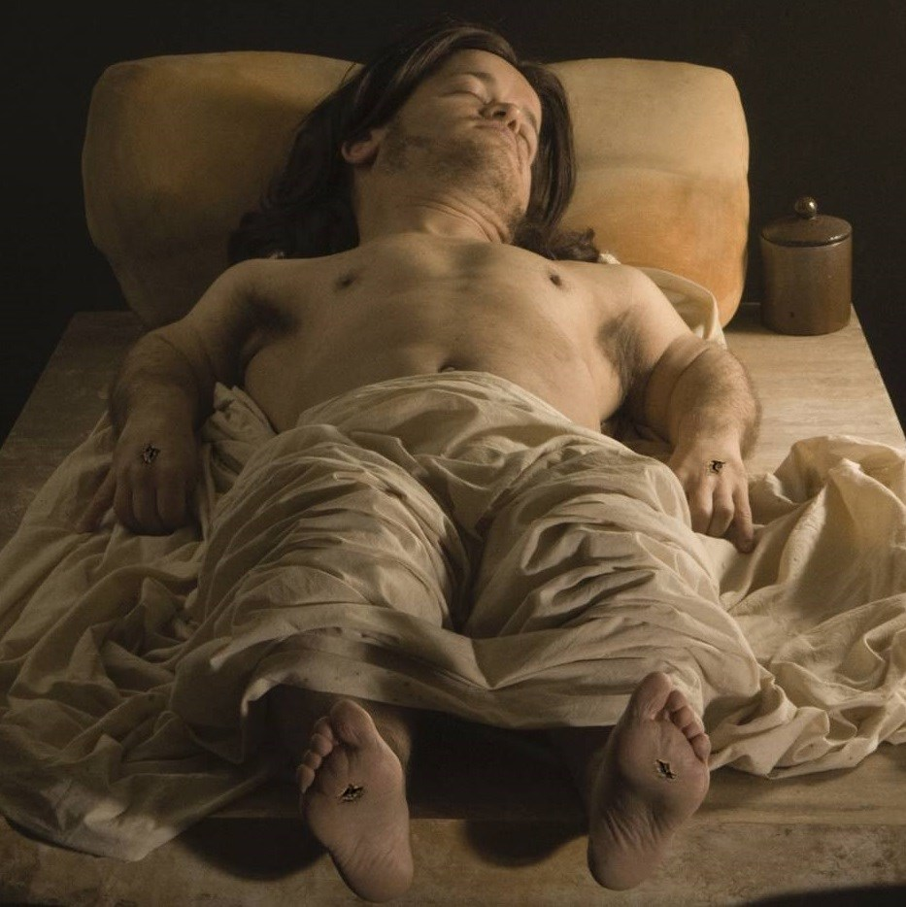
Notes:
I thought I would end by showing you some more work by disabled artists from the Shape/NDACA collections alongside these historical photographs from those past political struggles…
Tom Shakespeare has achondroplasia, a form of dwarfism, which he exploits in this self-portrait, bottom left, where he recreates the Lamentation of Christ – the original painting, top right, was made by Mantegna in about 1480 - Mantegna experiments with the concept of perspective and dramatic fore-shortening, whilst Shakespeare cleverly plays with this concept of fore-shortening as a real-life short person, a person of restricted growth…
NEXT SLIDE

Slide 7
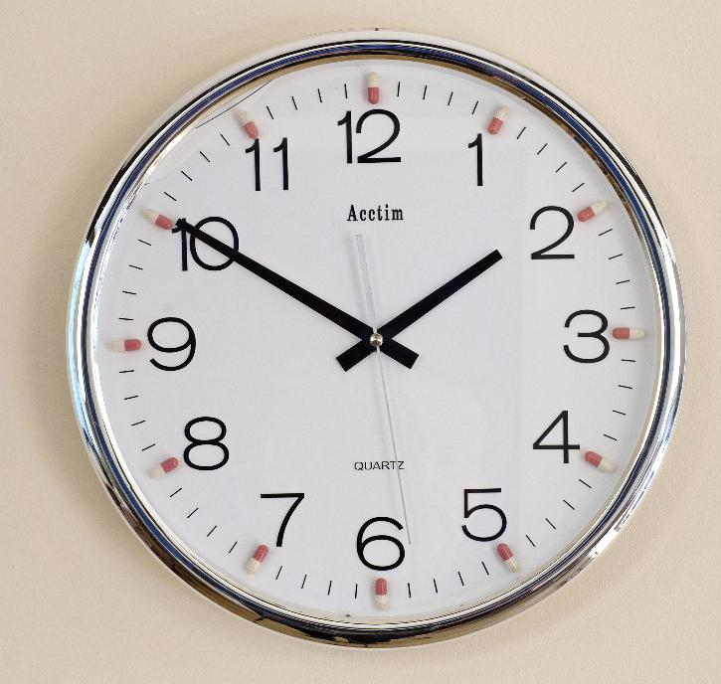
Aidan Shingler
Medication Time
Notes:
Aiden Shingler, Medication Time… I think this work is self-explanatory if you look closely enough…
Treating the symptoms not the causes perhaps, this is one of many works that draw us to think about the way we deliver mental health services…
Next Slide…

Slide 8
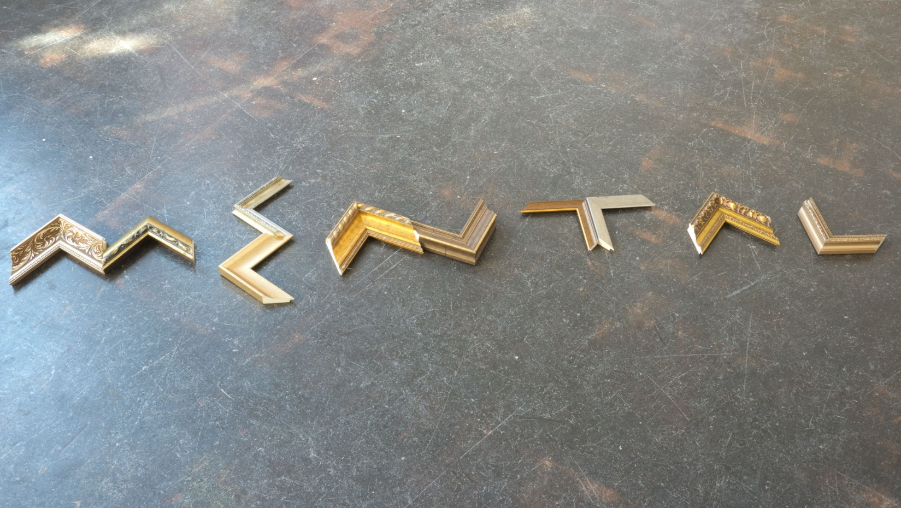
Simon Raven: Mental Frame
Notes:
Simon Raven, Mental Frame…
One in four adults has been diagnosed with a mental illness but Despite it affecting so many of us, prejudice still exists -
94% of Learning Disabled people are still unable to find meaningful employment… at a time when Unemployment is the lowest since 1975.
Next slide

Slide 9
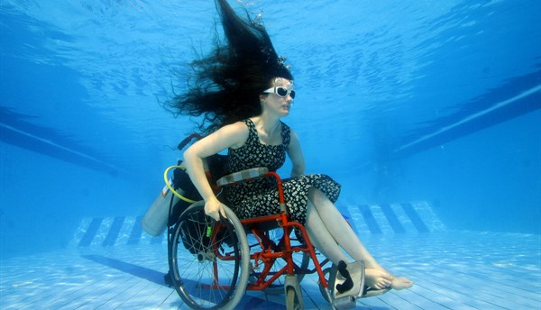
Sue Austin: Portal
Notes:
Sue Austin – Portal
In addition to the work in NDACA that highlights our oppression, there are also works, not just visual arts, but poetry, creative writing and images and film of dance and theatre that demonstrate the joy of life and the unique insight that disabled people can add to the arts and culture of our country - when given the opportunity the welcome and the resources to take part…

Slide 10
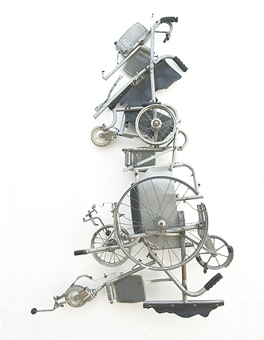
Great Britain from a Wheelchair
1994
Notes:
I hope that by celebrating Disability History - through Disability History Month - it will remind us of the need to build a better and more inclusive Britain, one that supports disabled people to have the same choices and rights as non-disabled people - and that we can learn from history to ensure we create accessible environments and develop inclusive practice in all aspects of our society so that disabled people can have what you have, its not difficult…. it just needs the right will and vision….
Thank you

