Slide 1
RESHAPING OUR FUTURE: THEATRE AND DISABILITY
Tuesday 11th October 2016
Park Theatre

Slide 2
Welcome
From Jez Bond,
Artistic Director of Park Theatre

Slide 3
Sorry – a verbatim theatre piece outlining the challenges for disabled artists today
Jenny Sealey, Artistic Director of Graeae Sorry -

Slide 4
The history of use of language and stereotypes in theatre
Richard Rieser, UK Disability History Month Co-ordinator

Slide 5
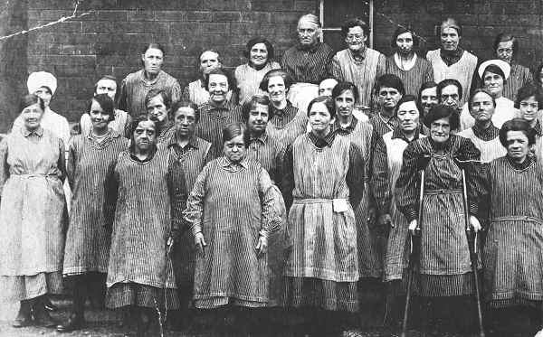
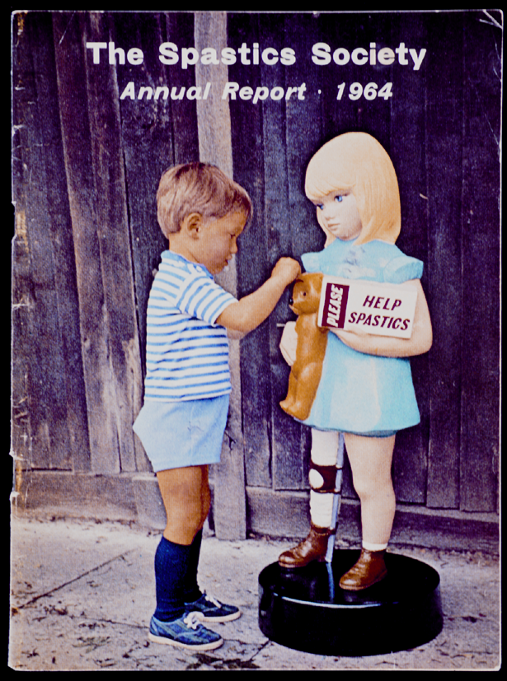
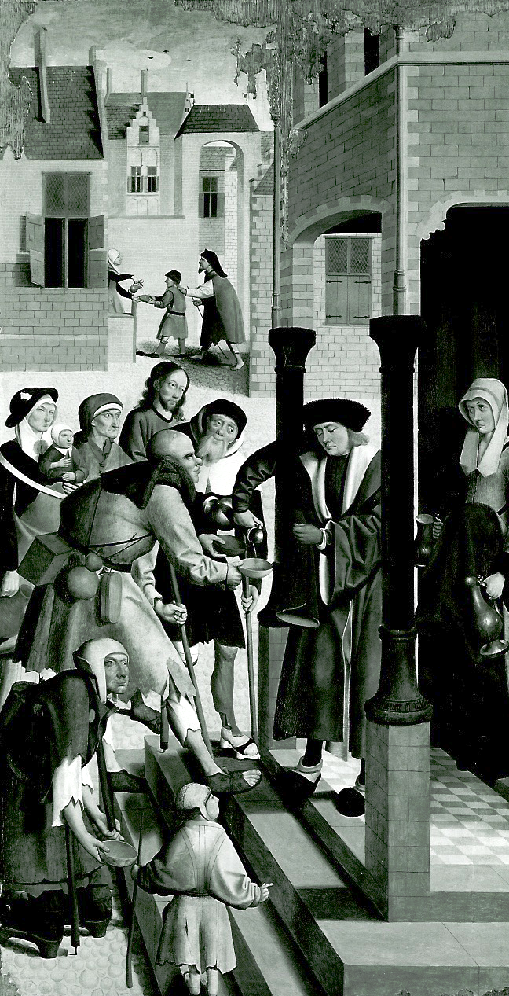
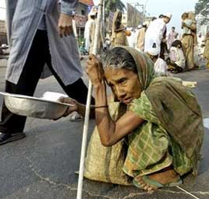
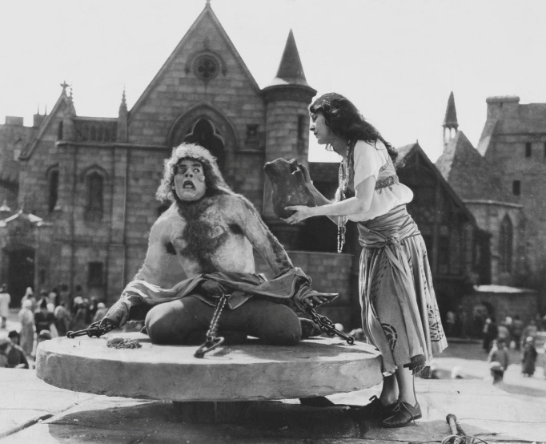
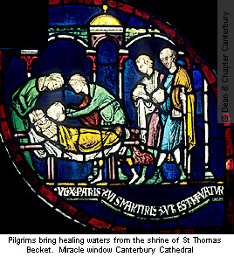
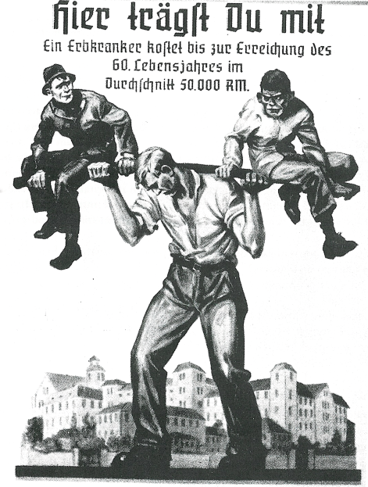
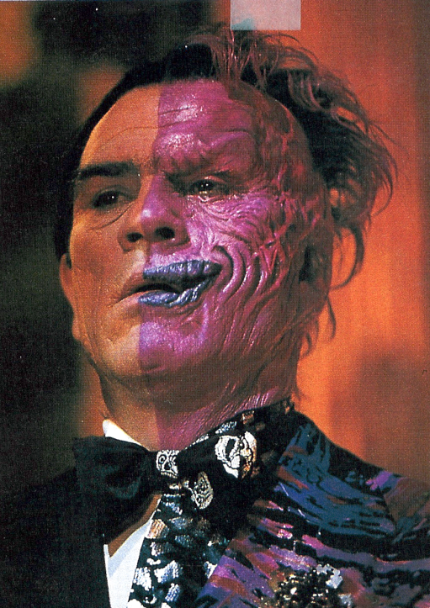
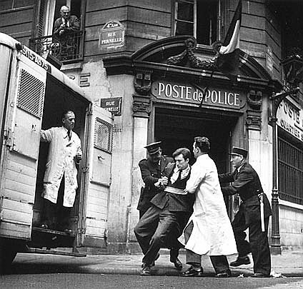
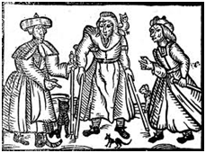

Slide 6
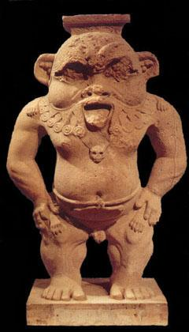
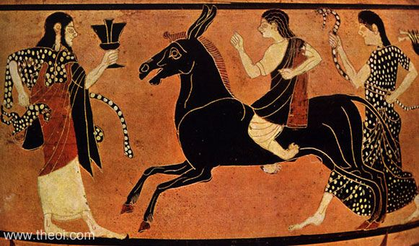
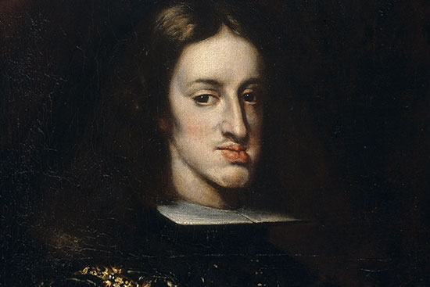
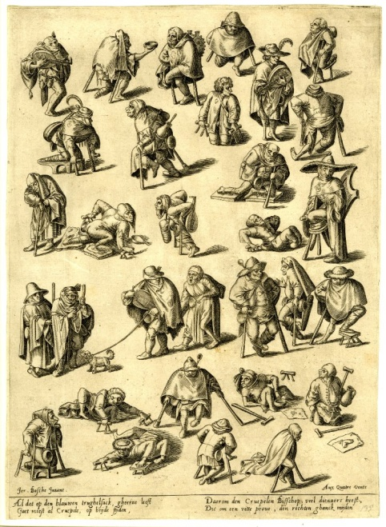
Charles II Spain
Hephaestus
Bes
Throughout human history and prehistory, disabled people have been part of human existence.
Responses have varied:-
Disabled people completely rejected - outcasts.
Economic liabilities- grudgingly kept alive by their families. Tolerated.
Respected status - participating to the fullest extent.
Predominantly attitudes were negative.
Bosch

Slide 7
Common Disability Stereotypes
Struggling to overcome impairments /finding cure
Sinister or evil
An object of pity
A passive victim/object of violence
An object of curiosity/freak show/atmosphere
A figure of fun
A burden/life not worth living
A chip on her/his shoulder, aggressive avenger
Triumphing over tragedy of ‘disability’
Incapable of an adult/sexual relationship
A prosthetic for a weak plot

Slide 8
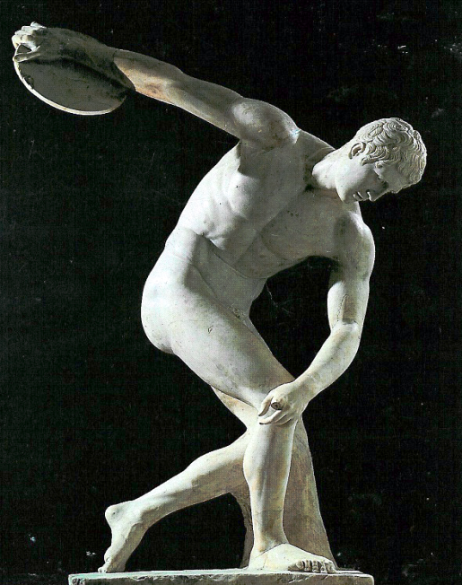
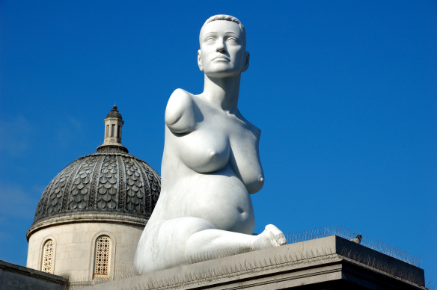
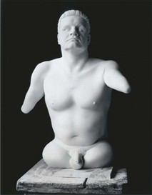
Body Beautiful
Western culture from Greek and Roman times, reinforced in Renaissance Europe, saw the "body beautiful" as an ideal.
Those with physical or mental imperfections were seen to be receiving divine retribution, or expendable.

Slide 9
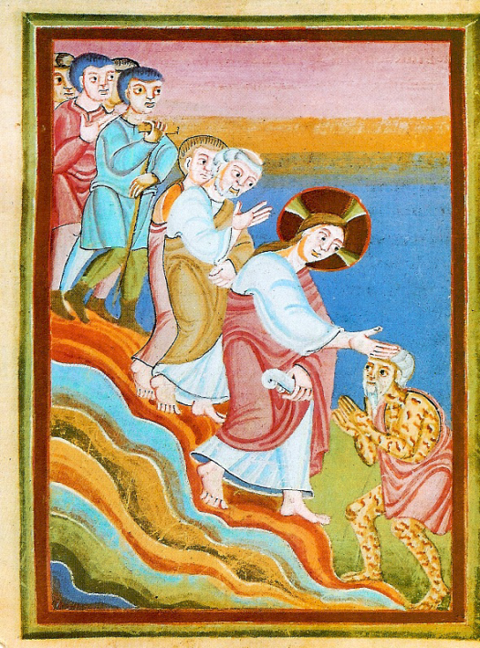
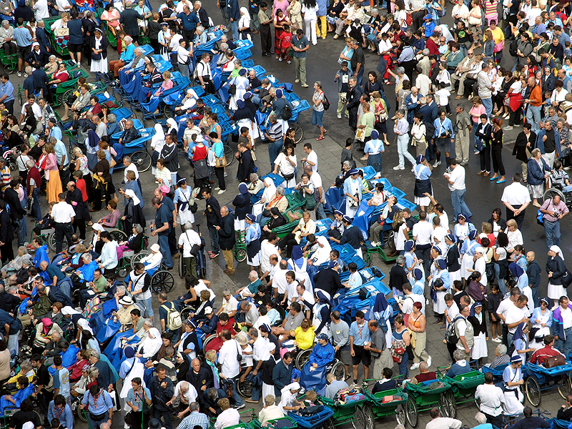
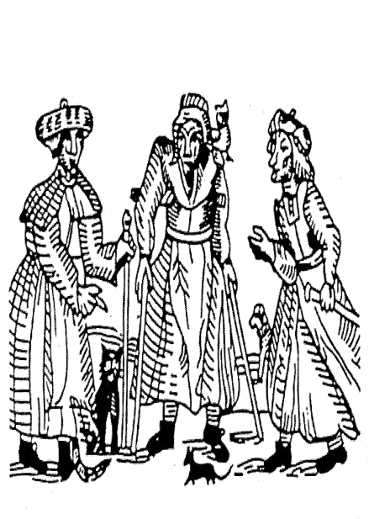
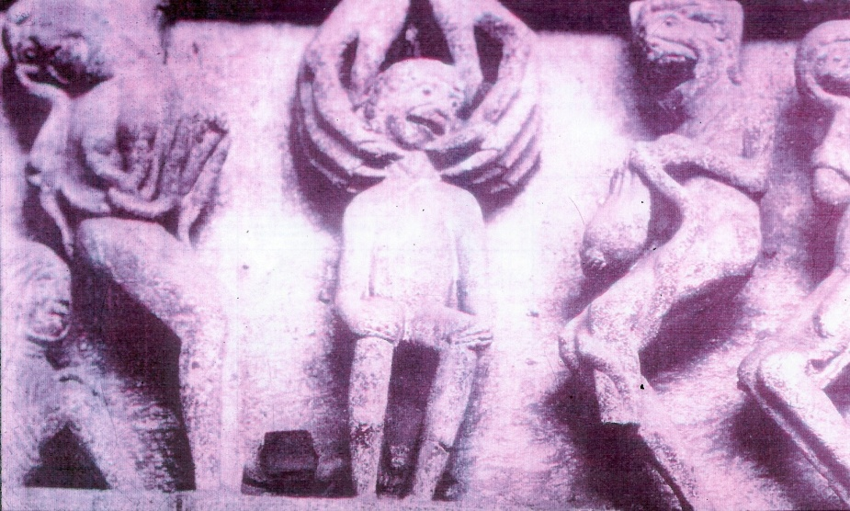
Disabled people as evil or sinners

Slide 10
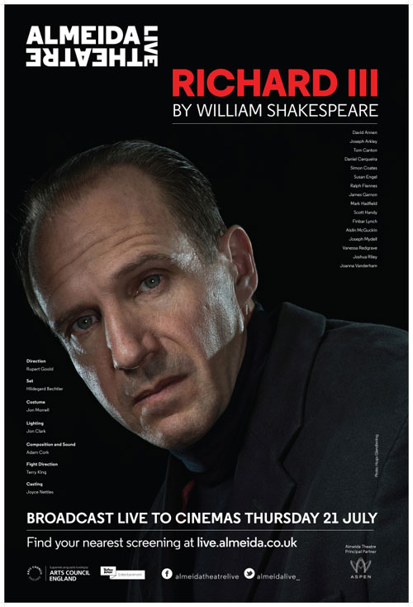
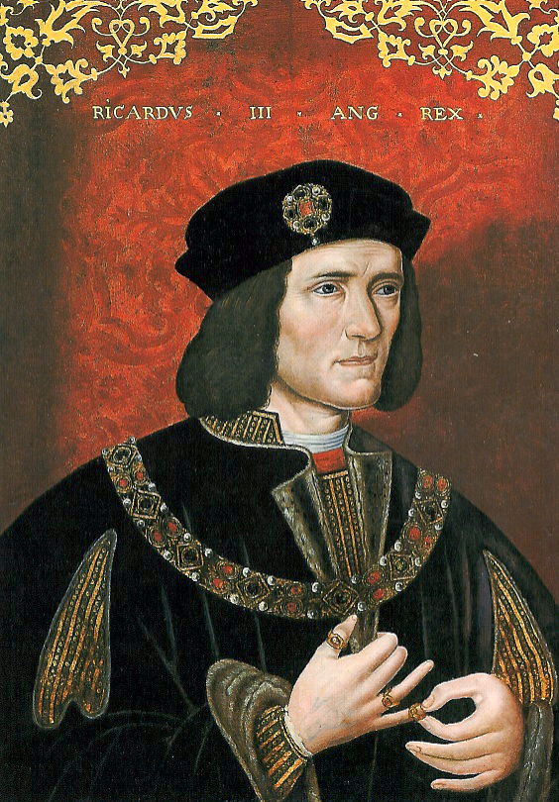
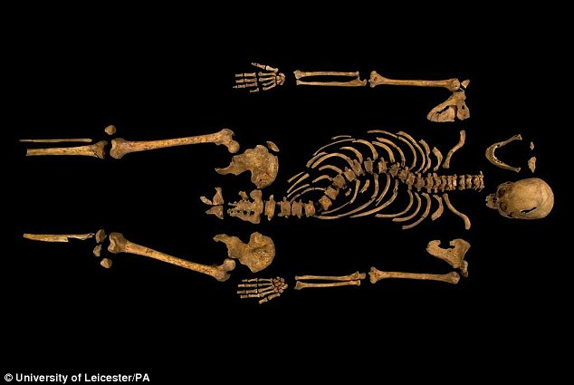
Richard III- The ultimate evil king or was he?
“...I, that am curtail'd of this fair proportion, Cheated of feature by dissembling nature, Deformed, unfinish'd, sent before my time Into this breathing world, scarce half made up,”
Based on Thomas Moore
Scoliosis -hunchback (Yes)
Lame Leg ( No)
Withered Hand ( No)
Mass Killer (?)

Slide 11
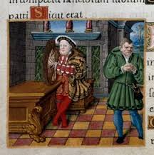
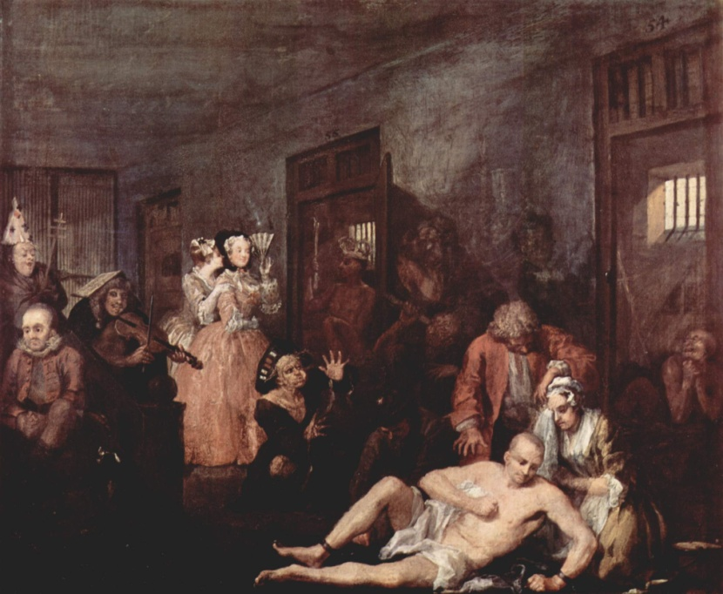
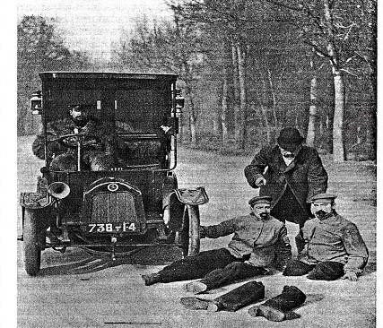
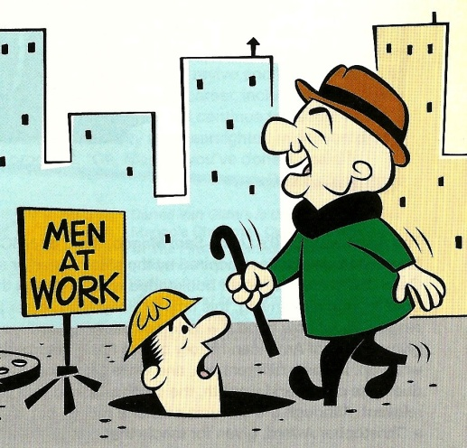
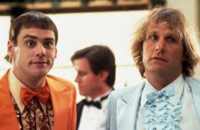
Laughable or the butt of jokes

Slide 12
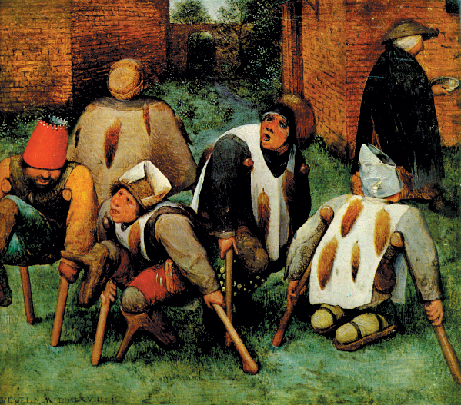
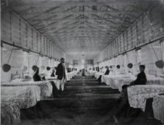
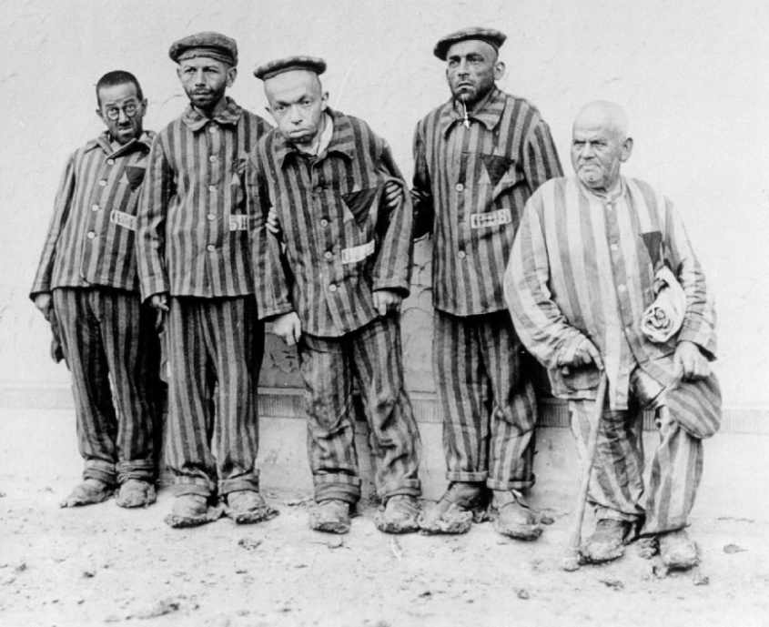
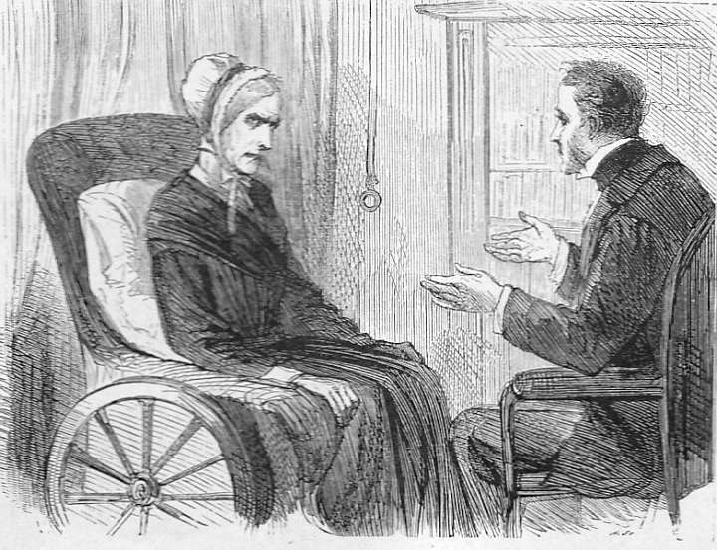
Disabled People as a Burden
Notes:
3.Little Dorritt Mrs Clannam
1. The Cripples Peter Breughel the Elder
4 . St Martin of Tour

Slide 13
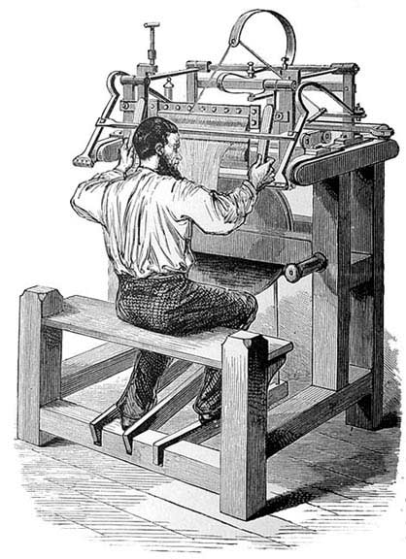
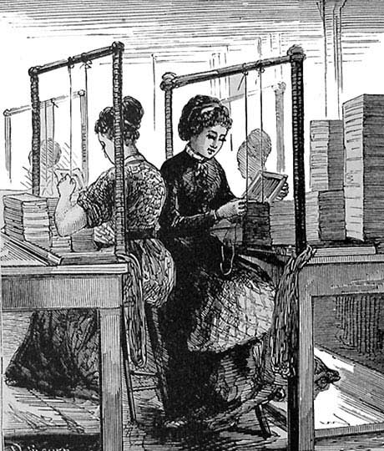
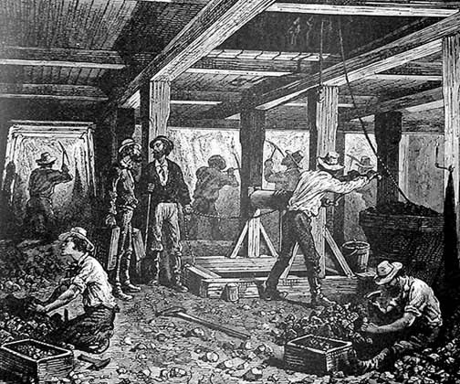
The decline of feudalism. Shift to urban and industrial society.
Until this period, disabled people had lived and worked with their families. Now it all changed!

Slide 14
Eugenics in the Ascendancy
"I do not see why any insolence of caste should prevent the gifted class, when they had the power, from treating their compatriots with all kindness, so long as they maintained celibacy. But if these continued to procreate children inferior in moral, intellectual and physical qualities, it is easy to believe the time may come when such persons would be considered as enemies to the State, and to have forfeited all claims to kindness.“ Sir Francis Galton
(Fraser's Magazine 7 [1873] quoted in Aristotle to Zoos, Peter and Jean Medawar, 1983 p. 87)

Slide 15
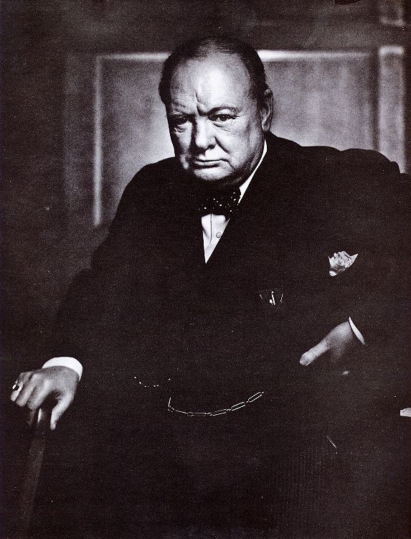
EUGENICIST THINKING
“The unnatural and increasingly rapid growth of the feebleminded classes, coupled with a steady restriction among all the thrifty, energetic and superior stocks constitutes a race danger. I feel that the source from which the stream of madness is fed should be cut off and sealed up before another year has passed.”
Winston Churchill MP, Home Secretary 1913 -Mental Deficiency Act
1

Slide 16
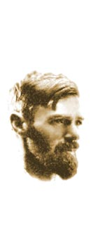
Eugenicist Thinking
“If I had my way, I would build a lethal chamber as big as the Crystal Palace, with a military band playing softly, and a cinematograph working brightly; then I’d go out in the black streets and the main streets and bring them all in, the sick, the halt and the maimed; I would lead them gently, and they would smile me a weary thanks; and the band would softly bubble out the ‘Hallelujah Chorus’.”
D.H. Lawrence, 1908
Other authors shared these views: H.G. Wells, Aldous Huxley, Bernard Shaw, Sidney and Beatrice Webb, John Maynard Keynes, William Beveridge.

Slide 17
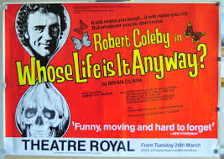
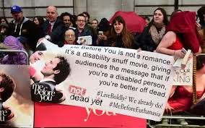
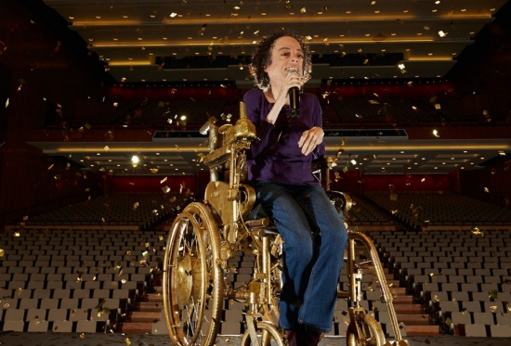
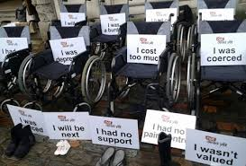
Are Disabled People’s Lives Valued Today?
Assisted Suicide the Musical

Slide 18
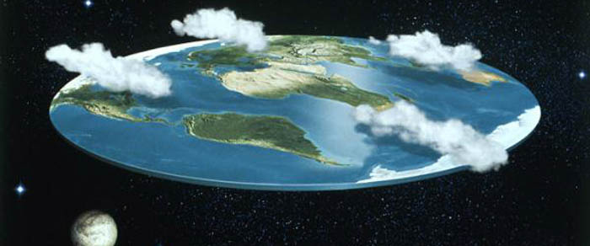
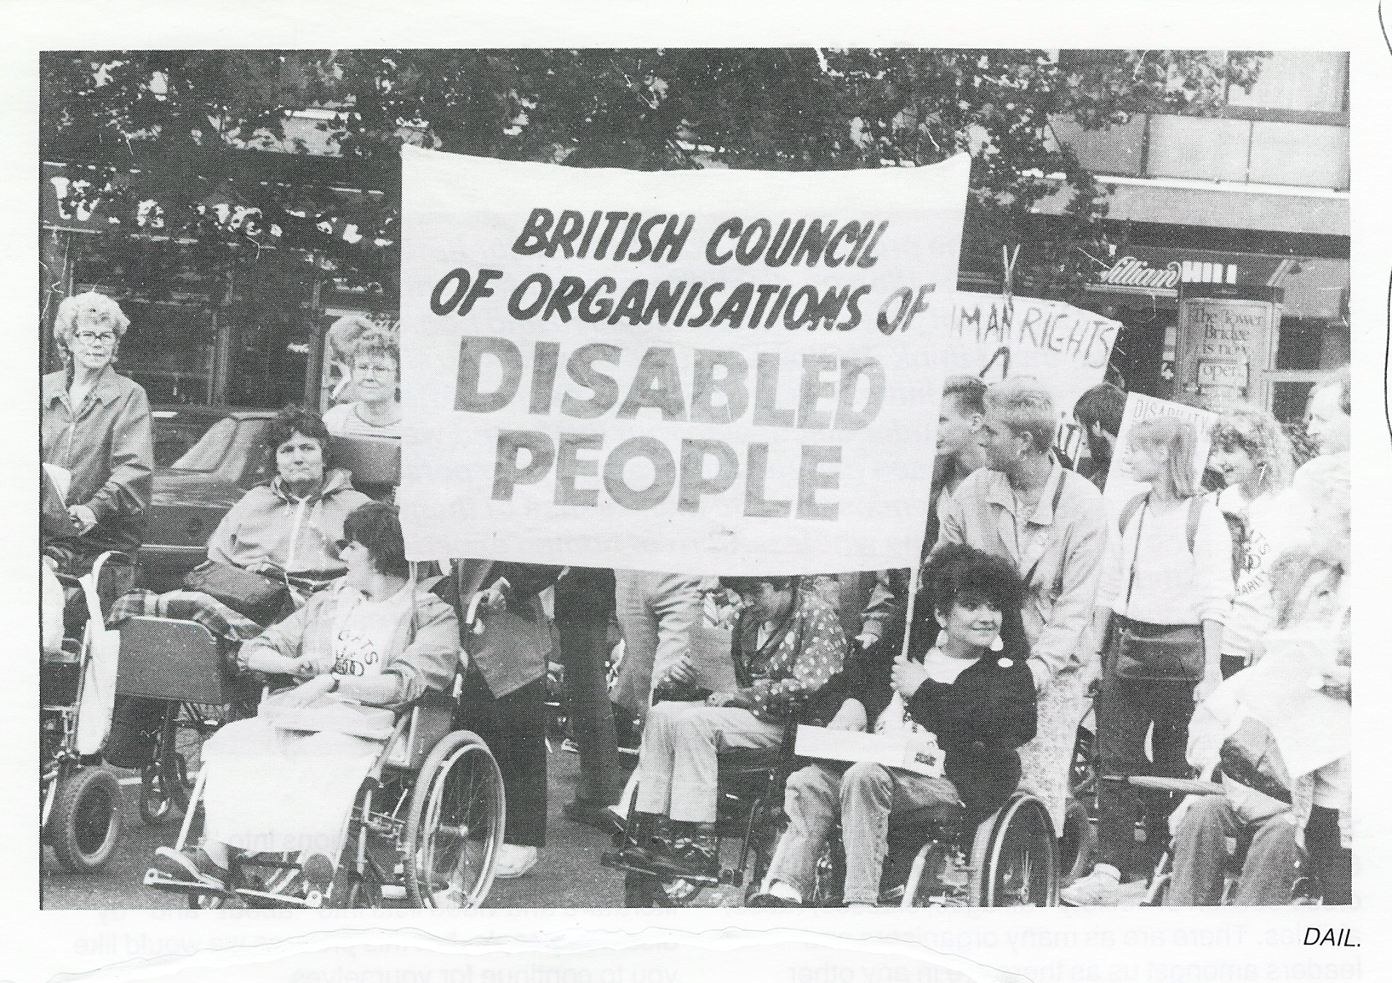
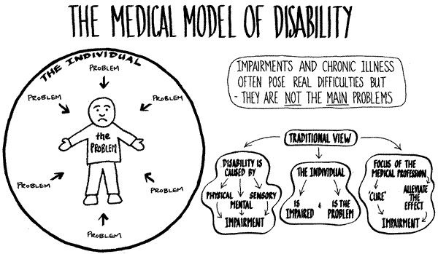
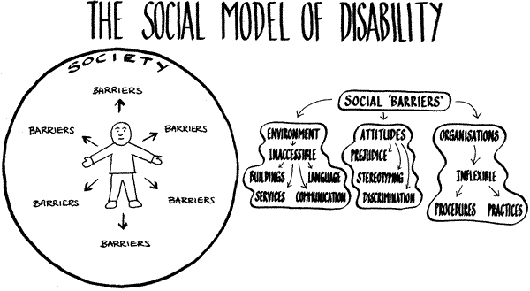
Are You a Disability Flat Earther?
Join the Paradigm Shift
We are not objects but subjects in our own liberation.
Be 0ur Allies

Slide 19
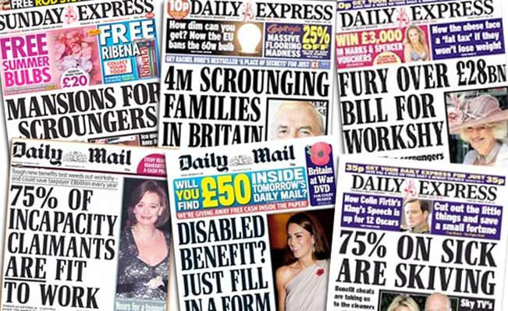
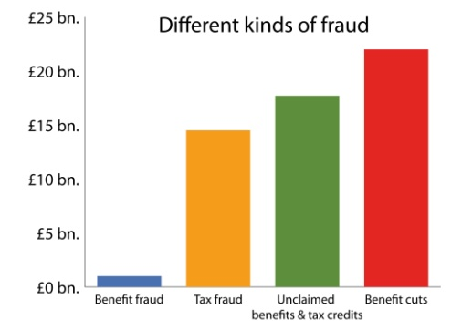

Slide 20
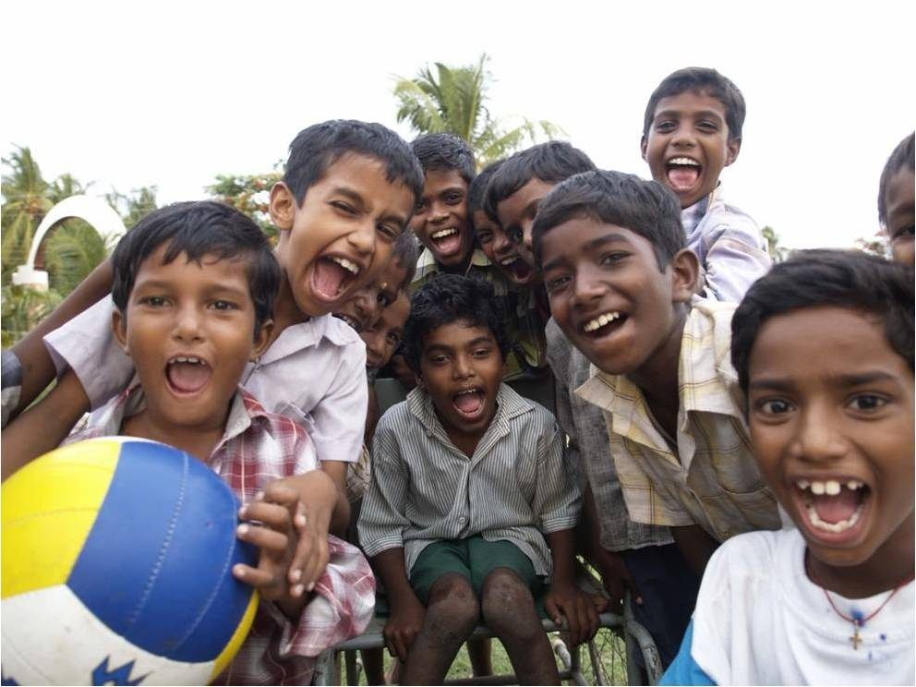
United Nations Convention on the Rights of People with Disabilities
166 countries have agreed
Full human rights for all disabled people- 1,000,000,000
Barriers of environment, attitude and organisation need to change
Nothing About Us Without US!
Biggest challenge in UK- attacks on Human Rights and austerity measures.

Slide 21
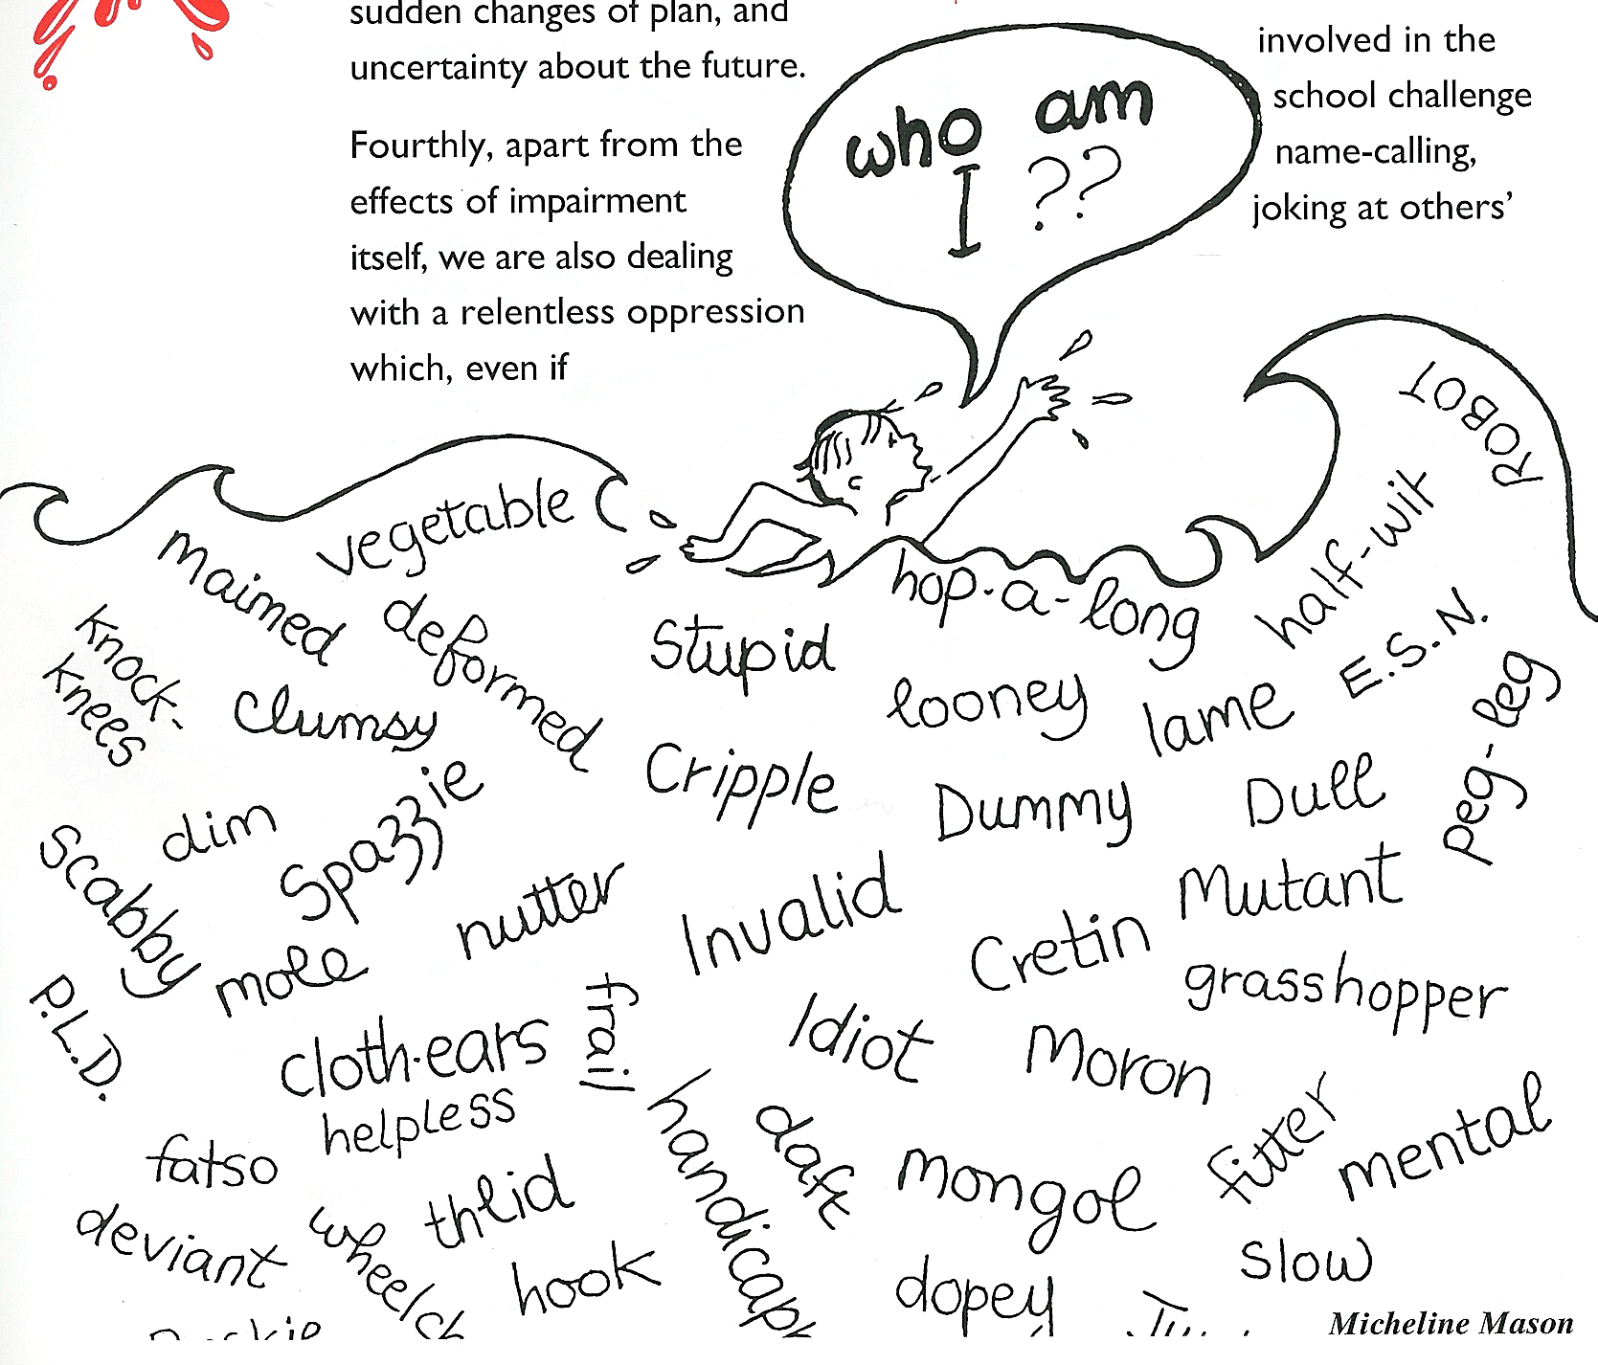
Offensive Language
Retard
Spaz or Spastic
Idiot
Mong
Moron
Stupid
Cripple

Slide 22
Theatre Disability Representation
Ways forward
Explore our history and struggle for equality
Non-stereotyped characters
Scripts which include disabled people’s lives
Opportunities for disabled actors to play any part-cross casting
Involve and develop disabled writers, directors and technical support workers
Make performances accessible

Slide 23
Are Things Changing?
Three penny Opera NT 2016
The Tempest: Paralympic opening 2012
The Solid life of Sugar Water 2015/16
GRAEAE at NT
The Government Inspector 2016 Ramps

Slide 24
Do we have to keep re-cycling old ideas?
Phantom of the Opera

Slide 25
Notes:
Pablo Pineneda
Aimee Mullins
Subhreet Kaur Ghumanhas
Harriet Tubman

Slide 26
How long will those who were disabled children in 1995 wait to view themselves as part of everyday life?

